Slide 1
Compound Interest

Slide 2
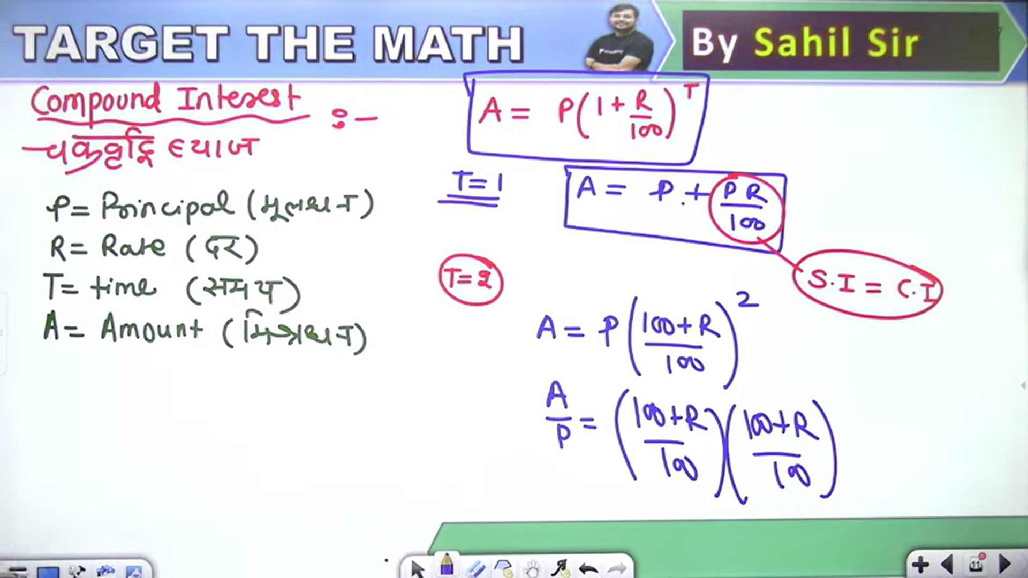

Slide 3
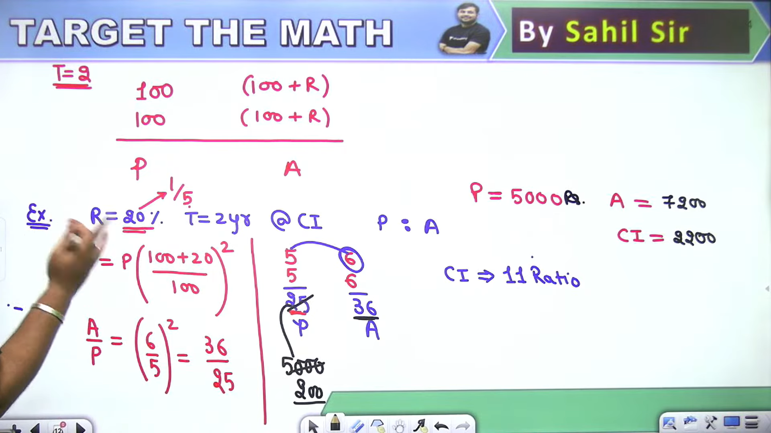

Slide 4
